Slide 1
Group 32
Matthew, Junwei, winston
We are going to fail!!! yey

Slide 2
Concept Ideation
Originally, we wanted to make a fighting scene, cause why not, which led to the theme of bullying and fighting. We turned it into a “What should you do when you are bullied” type of sketch, to look at it from another perspective. We also adopted a comedy themed approach to lighten the mood. Thus, we searched up Singapore comedy channels: ”Night Owl Cinematic” and ”Wah Banana”. We used jump cuts due to the time constraints of 1 minute and for the comedic effect.

Slide 3
Video Story Type: fiction, short film
Log Line: MC is a loner, does not have real friends, first by faking weakness to others, then showing superiority and beating up a bully. Thus, he gets followers and becomes famous within the school.
The concept of the film (what if?): What if the victim fights back against the bullies?
The vicarious experience(s) in your story(what would it be like…?): What would it be like to bully a martial artist?
Main Theme: Bullying, it occurs to anyone of any age, race, religion, and we need to do something about it.
Conflict breakdown of the protagonist(want/buts of the protagonist): Martial arts is a form of protection, not to be used in revenge or to hurt others weaker than him. MC takes revenge on the bullies, which goes against what he has learnt.

Slide 4
Explanation of theme
Our theme is about what would happen if a timid trained martial artist person gets bullied by his classmates and does not know whether he should fight back or not because he does not know it is the right thing to do or not.We decided to have bullying as the theme because we wanted to show that people should not judge other people by their appearance . We also used zoom in shots in the clips to show the reaction of the protagonist

Slide 5
Start of the film: MC waking up, then in school,”I'm so excited for my first day of class, who knows how many new friends i will meet today.”
Inciting Incident: It occurs when the bullies purposely bumps the victim on the shoulder forcefully and bullies acts aggressively.
(Shows that MC does not actively incite anger and violence)
1ST PP: Victim(Jun Wei) acts weak and backs away while apologizing profusely but the lead bully(Matt) shoves victim to the wall MC is backed against the wall. Bullies stand opposite him, blocking his path of escape. Lead bully(Matthew) attacks MC, the other bully(Winston) stands back and watches, laughing. SDA stops them because of social distancing rule, and bullies back away aggressively and starts threatening MC.
(shows that the incident is not yet over, which causes fear of being bullied)
Midpoint: Victim talks to his online friend about recent bullying(discord). Victim asks friend for advice on what he should do regarding the situation. Friend’s identity is still uncertain now.
(Shows conflict between the situations)
2ND PP: Mc reaches breaking point after a few days of continuous bullying, A random stranger(Basil) saw the entire fight and decided to record it and post it on social media.
Climax/Plot twist: he breaks and fights back, beating up the bullies(he knows how to fight/martial arts). Bullies run away in fear.
(Shows that MC will do what it takes to protect himself)

Slide 6
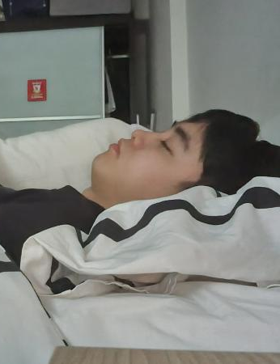
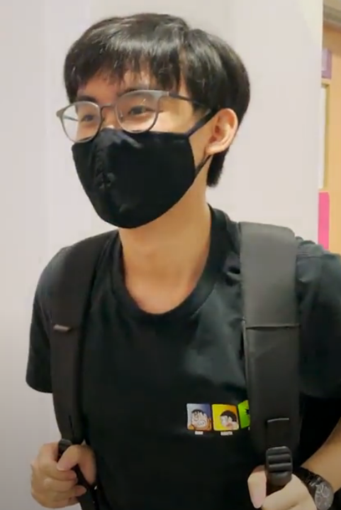
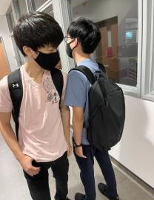
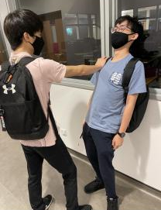
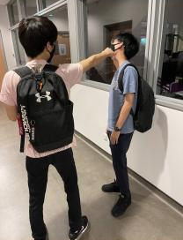
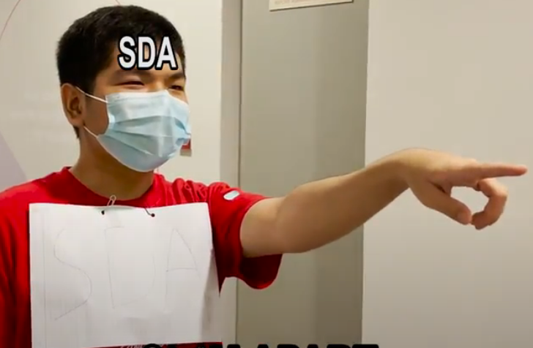
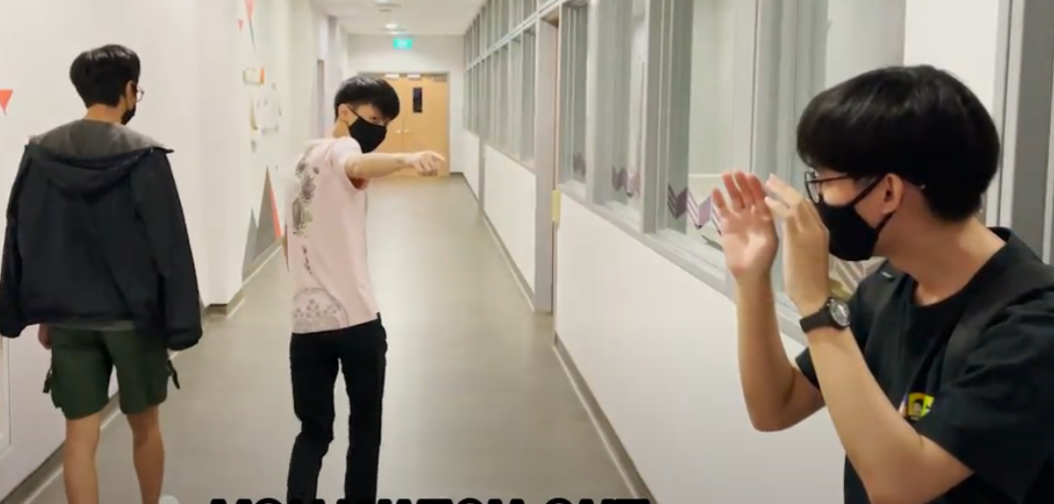
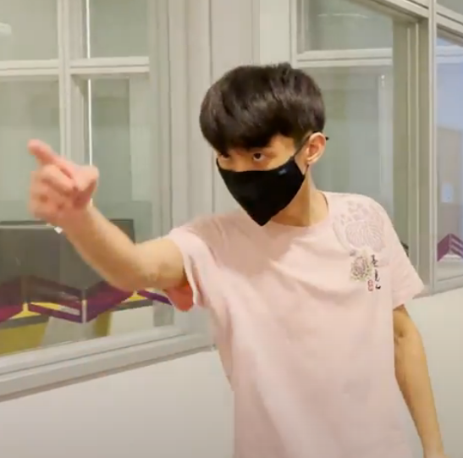
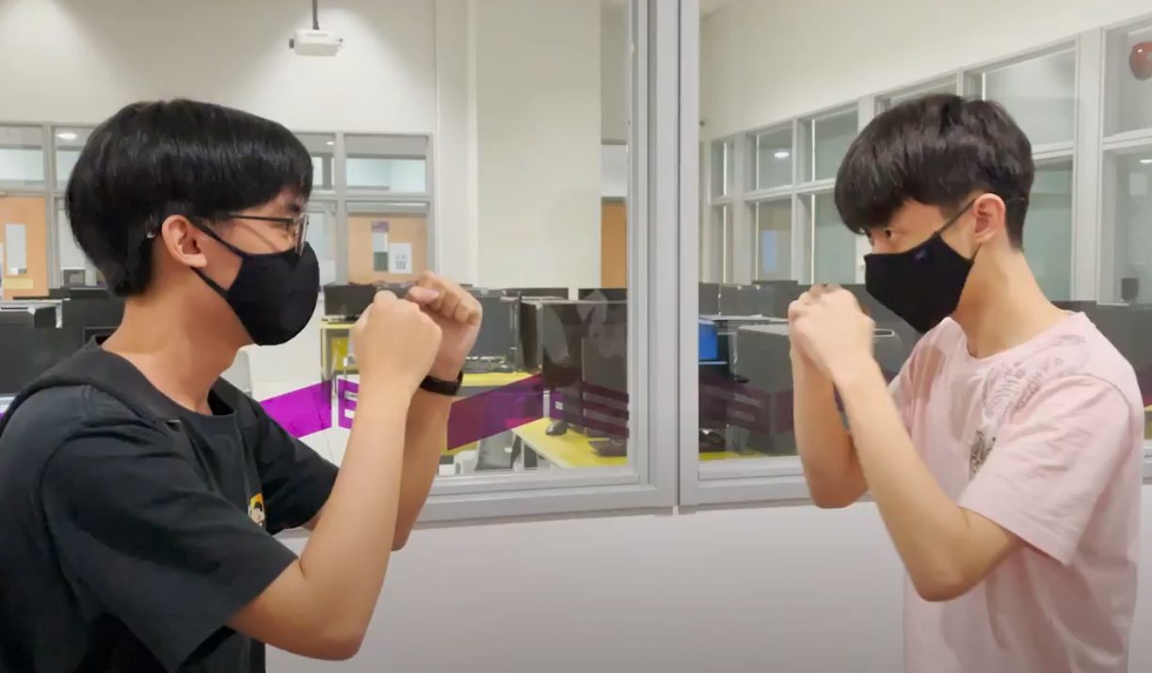
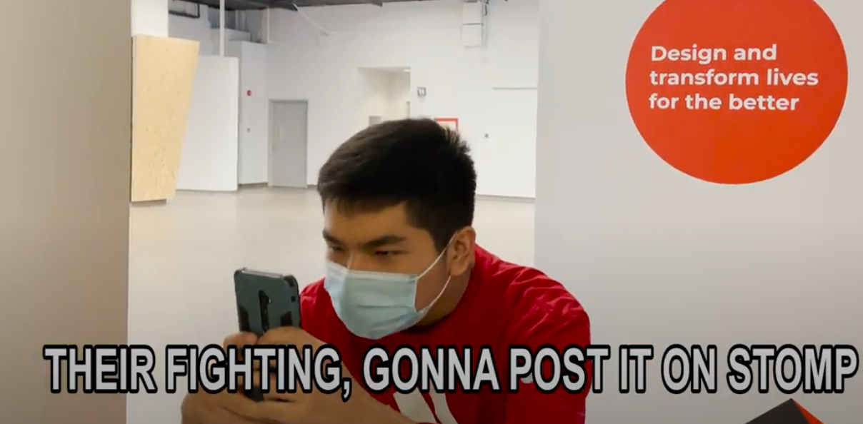
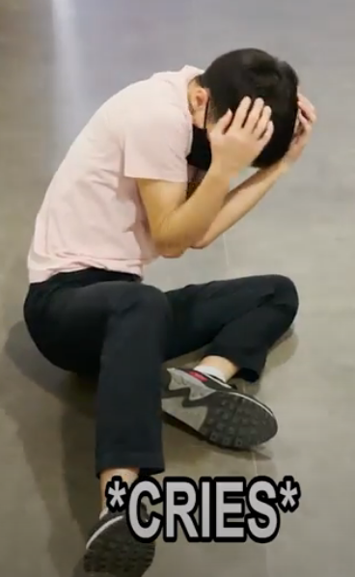
StoryBoard

Slide 7
Individual contributions
10-15 mins, slides include group report, storyboard, individual contributions, concept ideation
Matthew : Editing / Filming
Winston : Script writing / Filming / Slides
Jun Wei : Protagonist / Filming / Slides

Slide 8
Mentions:
Winston’s idea: We all agreed on a fighting sequence, so my idea was to have a gang fight, which the police would breakup the fight. After that, the protagonist will go to jail and reflect on his actions, which leads back to the start of the fight, and why they fought in the first place. This gives the protagonist regret and shame, but also anger that they didn't finish the fight. Thus, having internal conflict. The theme/moral would then be to not have poor friends, not in the financial sense, but in the moral sense, rather the poor influence of uncultured individuals.
Jun wei’s idea: My idea was for it to be much darker theme, starting off quite similar with the protagonist being bullied by two of his classmates but having being bullied by the two classmates so many times before. This time he decided to fight back and actually won and later on he becomes the most popular kid in school.But, everything was just a dream with the final shot of the clip being the protagonist lying down on a hospital bed with a coma barely surviving.The theme/moral of the story would be do not try to fight back if you cannot and always ask for help from an adult.

Slide 9
Thank you
ok goodbye :)

